Slide 1

By- SAROWER AHMMED

Slide 2
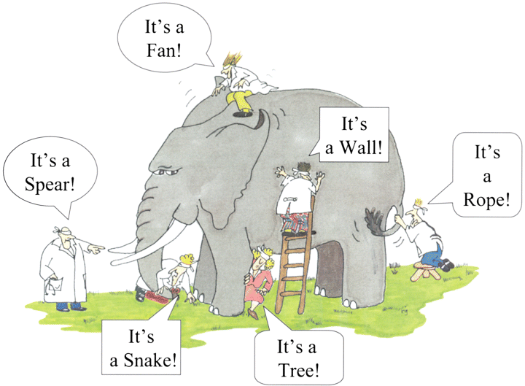
If you don’t understand business logic than elephant seems like below

Slide 3
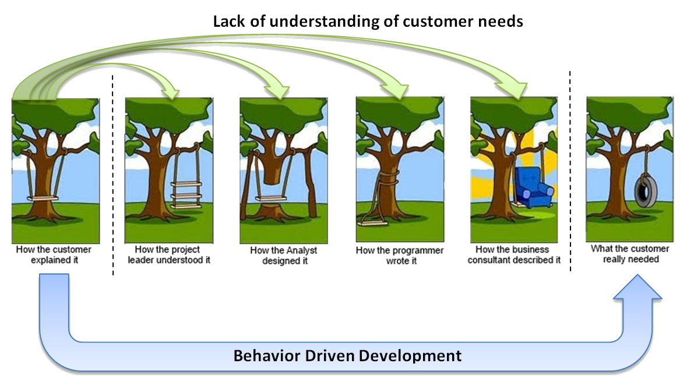

Slide 4
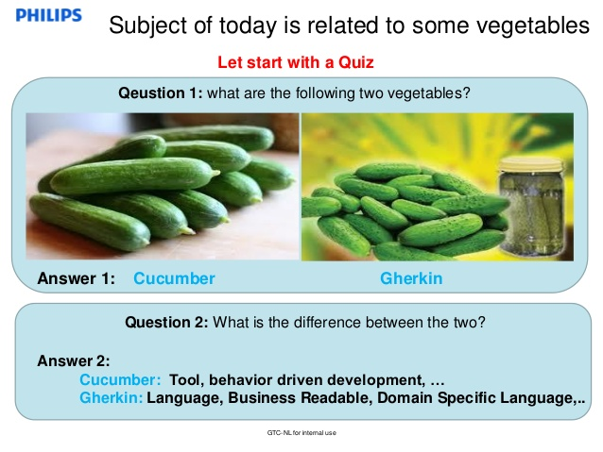
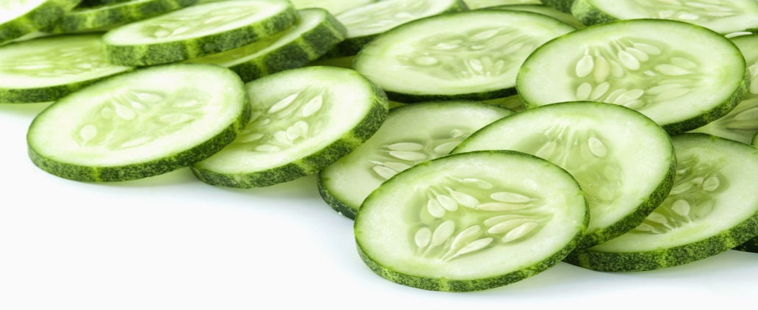
Cucumber(tool) as cool as cucumber.

Slide 5
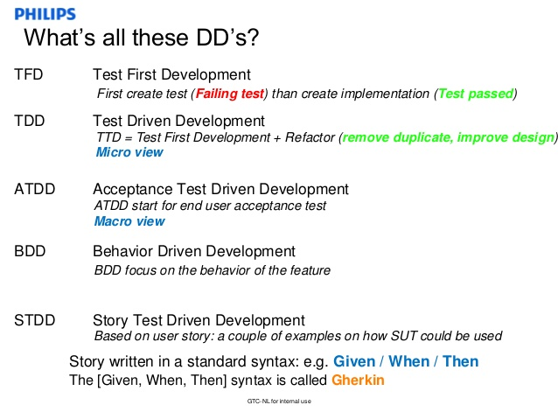

Slide 6
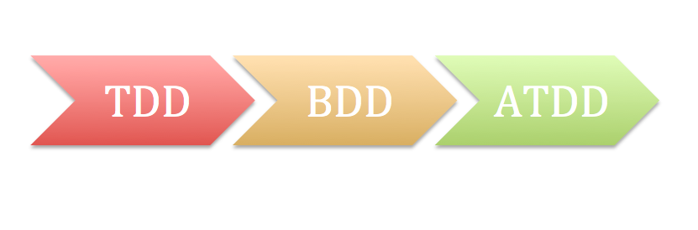
History of All DDDDDDDs

Slide 7
Cucumber Introduction
Test Driven Development (TDD)
Cucumber & Gherkin -Behavior or Business Driven Development (BDD)

Slide 8
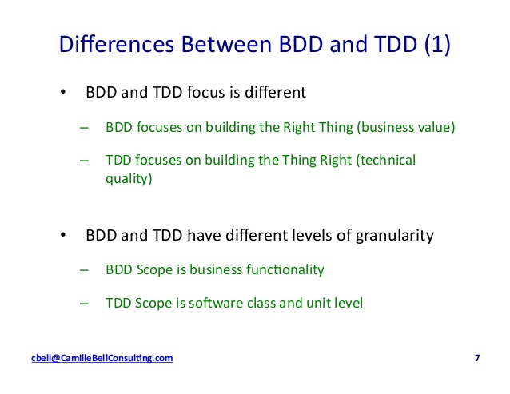

Slide 9
Behavior
Driven
Development
What TO Test
Behavior 1st concept : is a testing of the external behaviour
of the program, also known as black box testing. It is usually a functional testing.
How TO Test
Test
Driven
Development
Test 1st concept is to "get something working now and perfect it later." After each test, refactoring is done and then the same or a similar test is performed again.

Slide 10
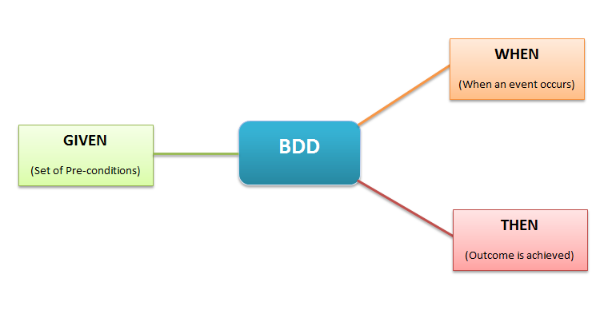
Gherkin – Business Driven Development (BDD)

Slide 11
Business behavior with feature file
A simple feature file consists of the following keywords/parts −
Feature − Name of the feature under test.
Description (optional) − Describe about feature under test and requirements.
Background(optional)- common steps.
Scenario or Scenario Outline− What is the test scenario.
Given − Prerequisite before the test steps.
When − Action
Then − After the action
AND , OR

Slide 12
1 2 3 4 5 6 7 8 9 10 11 | Feature: Login Action Scenario: Successful Login with Valid Credentials Given User is on Home Page And User Navigate to LogIn Page When User enters UserName and Password Then Message displayed Login Successfully Scenario: Successful LogOut When User LogOut from the Application Then Message displayed LogOut Successfully

Slide 13
1 2 3 4 5 6 7 8 9 10 11 12 13 14 15 16 17 18 19 20 | @regression @TS_123 Feature: Login Action @TC_345,@TC_567 Scenario: Successful Login with Valid Credentials Given User is on Home Page And User Navigate to LogIn Page When User enters UserName and Password Then Message displayed Login Successfully @TC_344,@TC_568,@TC_346 Scenario: Successful LogOut When User LogOut from the Application Then Message displayed LogOut Successfully

Slide 14
Data driven testing
Column and row
1 2 3 4 5 6 | Scenario: Successful Login with Valid Credentials Given User is on Home Page When User Navigate to LogIn Page And User enters valid username and password | testuser_1 | Test@153 | | testuser_2 | Test@154 | | testuser_3 | Test@155 | Then Message displayed Login Successfully
DataTable TABLE

Slide 15
MULTI SET DATA
PARAMETARIZATION
1 2 3 4 5 6 7 8 9 10 11 | Feature: Login Action Scenario Outline: Successful Login with Valid Credentials Given User is on Home Page And User Navigate to LogIn Page When User enters <UserName> and <Password> Then Message displayed Login Successfully Examples: | UserName | Password | | sarower ,ahmmed | Ttech123,Ttech456 | | mahbub,simon ,sumon | Ttech007, Ttech008,Ttech009 |
Example TABLE

Slide 16
Step def
Use cucumber annotation
@Given
@When
@Then
Create method l- public void
Connect pagefactory
Use cucumber for data driven testing and pass your data
Data table in simple scenario
Example table in scenario outline
Direct from excel
Direct from data base

Slide 17
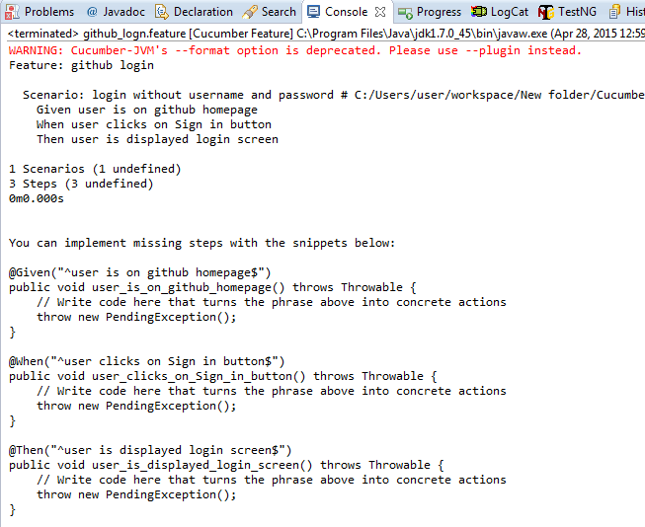
Snippet or skeleton for stepdef

Slide 18
Create cucumber hook
To handle some situations, cucumber hooks are the best choice to use. Unlike TestNG Annotaions,
Cucumber supports hooks
@before
@After
Also in junit but not in TestNG
Cucumber hook not same as unit testing framework but function is same
Junit | TestNG
@Before | @Before test
@After | @After test

Slide 19
Hook code
public class Hooks {
@Before
public void beforeScenario(){
System.out.println(“setup");
}
@After
public void afterScenario(){
System.out.println(“tead down");
}
}

Slide 20
Create cucumber hook
Why need hooks in cucumber:
Starting a webdriver
Setting up DB connections
Setting up test data
Setting up browser cookies
Navigating to certain page
or anything before the test

Slide 21
after steps as well of the tests like:
Killing the webdriver
Closing DB connections
Clearing the test data
Clearing browser cookies
Logging out from the application
Printing reports or logs
Taking screenshots on error
or anything after the test

Slide 22
Create runner file – TestNg runner file
@CucumberOptions(
plugin= {"pretty","html:target/cucumber", "json:target/cucumber.json"},
features= {"src/main/resources/Login.feature"},
glue= {"com.stepdef"},// package name
tags= {"@smoke"},
monochrome=true,
strict=true
///dryRun=true
)
public class TestNgRunner extends AbstractTestNGCucumberTests{
}

Slide 23
Cucumber Junit Runner
@RunWith(Cucumber.class)
@CucumberOptions(
plugin= {"pretty","html:target/cucumber"},
snippets=SnippetType.CAMELCASE,
strict=true,
monochrome = true,
//dryRun=true,
features= "src/main/resources/Features/Login.feature",
glue= {"com.usa.ttech.student.stepdefination"},
tags= {}
)
public class CucumberJunitRunner {
}

Slide 24
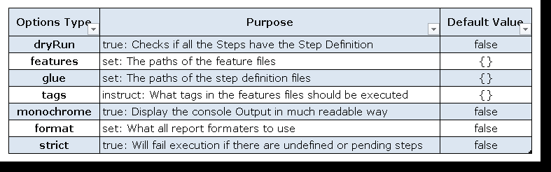
Cucumber options

Slide 25
Snippet Style
SnippetType.CAMELCASE
SnippetType.UNDERSCORE
You can set snippets in Cucumber Options.
@RunWith(Cucumber.class)
@CucumberOptions(format = {"pretty"}, monochrome = true,
snippets = SnippetType.CAMELCASE)
public abstract class CucumberUiTest

Slide 26
If you do not have Strict flag set to true then cucumber will not fail if there are any undefined or pending steps. You can set Strict to true in Cucumber Options.
@RunWith(Cucumber.class)
@CucumberOptions(format = {"pretty"}, strict = true,
monochrome = true)
public abstract class CucumberUiTest
{
}

Slide 27
Are you writing scenarios first and then implementing step definitions?
If so, dryRun switch will run your scenarios without executing any of the steps and gives you snippets of any missing step definitions. It invokes formatters without executing the steps. You can set dryRun to true in Cucumber Options.
@RunWith(Cucumber.class)
@CucumberOptions(format = {"pretty"}, dryRun = true,
monochrome = true)
public abstract class CucumberUiTest
{
}

Slide 28
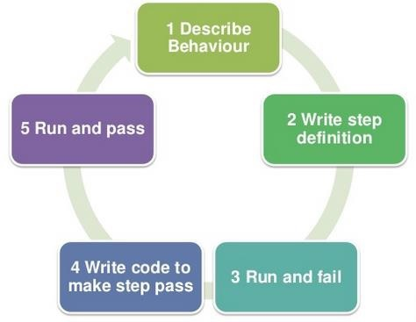
BDD & SELENIUM

Slide 29
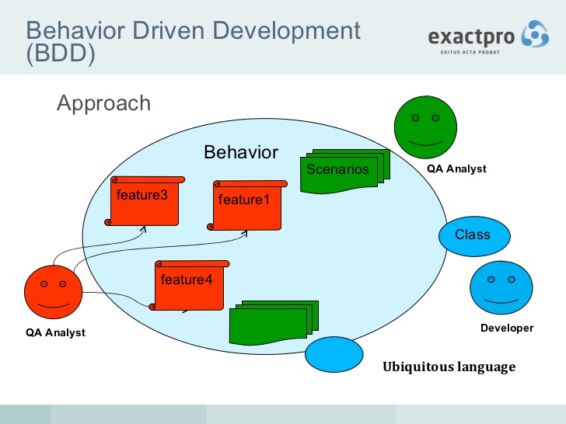
Code

Slide 30
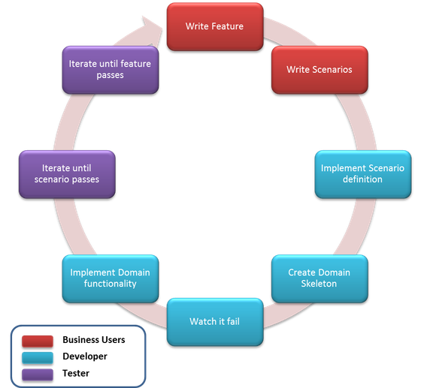

Slide 31
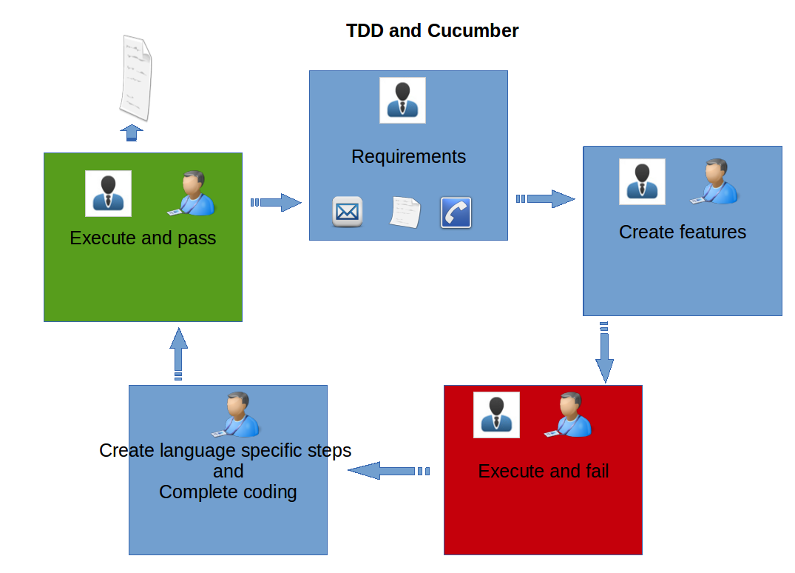
BDD/

Slide 32
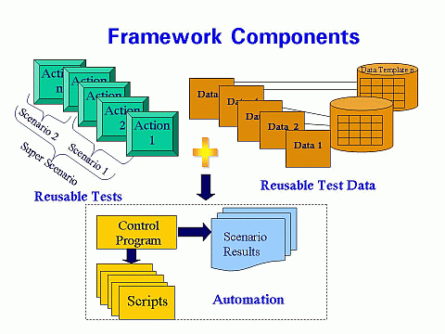

Slide 33
Cucumber Reports

Slide 34
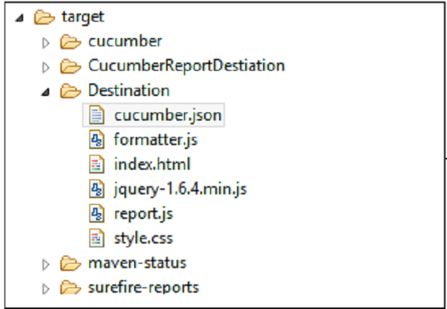
Most beautiful report with multi options

Slide 35
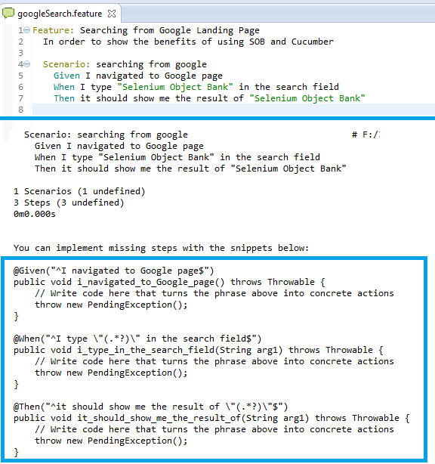

Slide 36
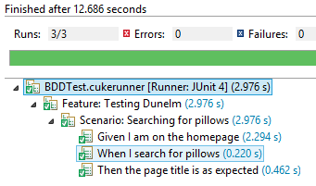

Slide 37
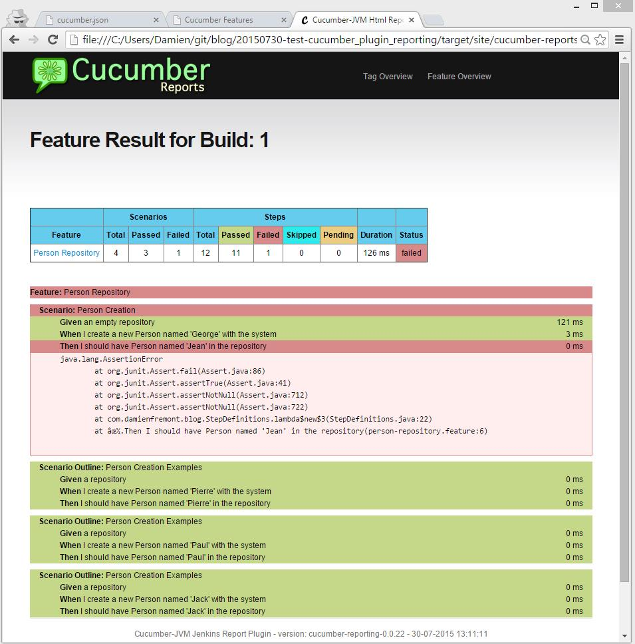

Slide 38
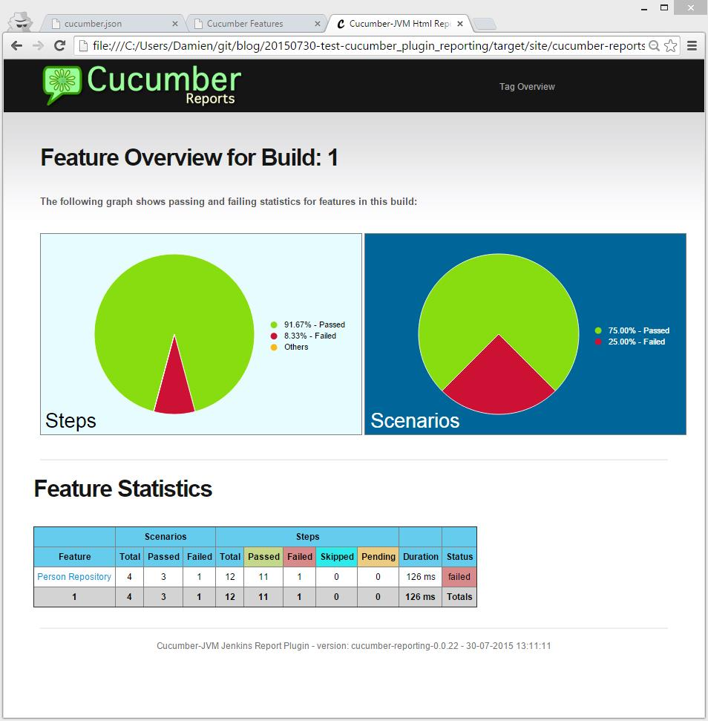

Slide 39
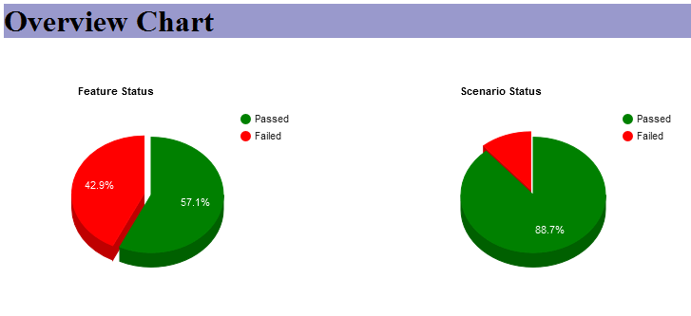

Slide 40
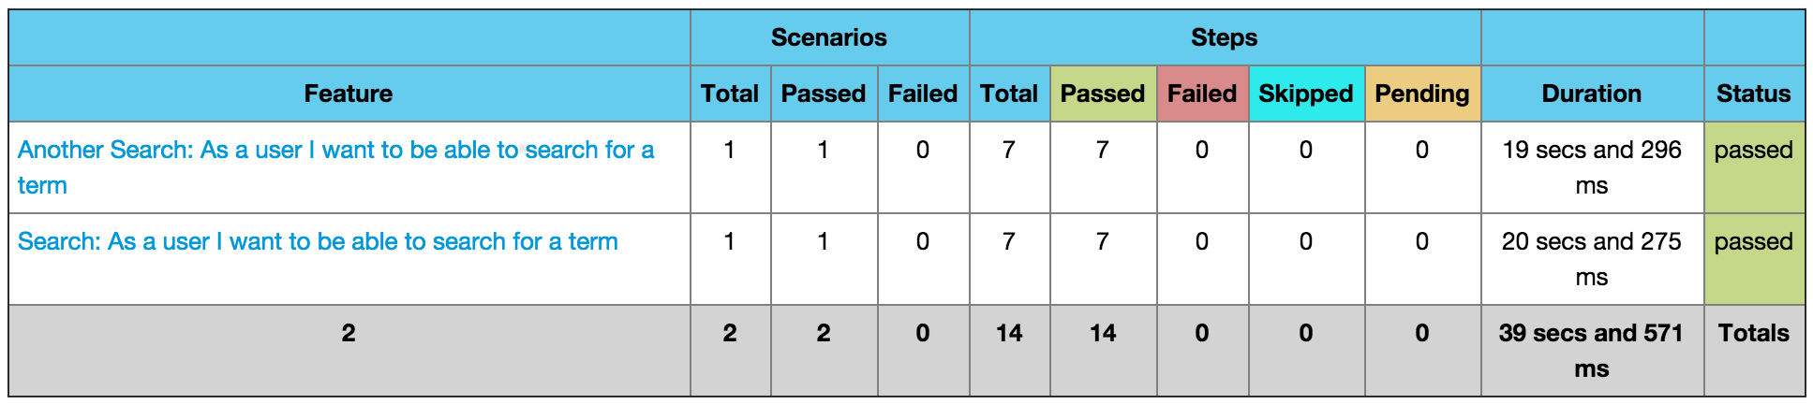

Slide 41
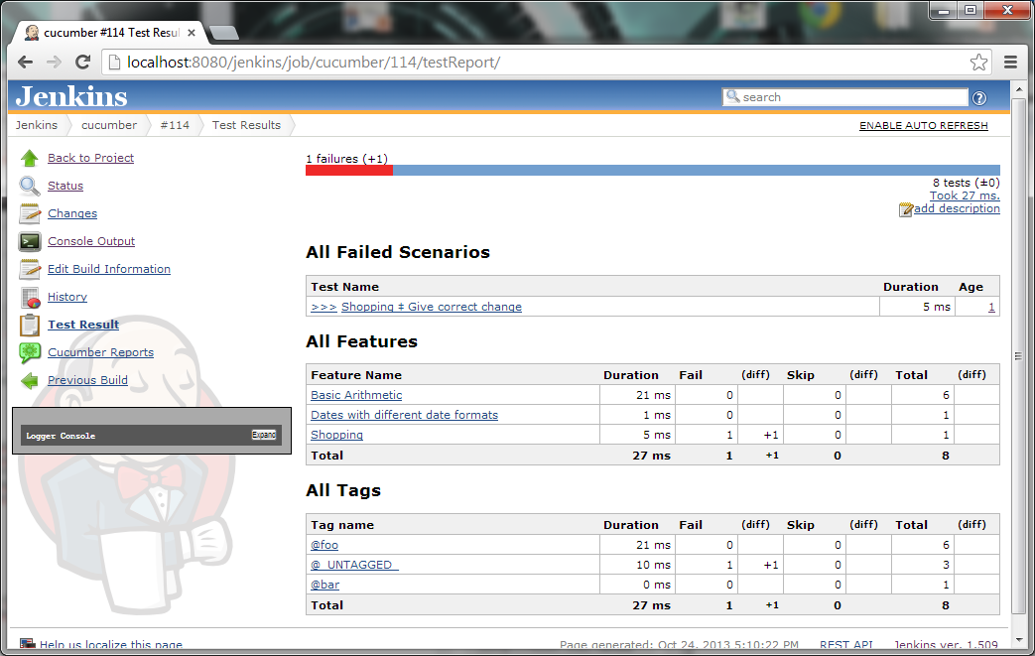

Slide 42
Conclusion
JSON is OK for integration with other tools (jenkins plugin, reports, etc).
JSON is less readable as compared to the HTML report format.
Pretty HTML is OK during development phase (like a JUnit or Surefire report).
Cucumber-Reports is good for reporting outside of the dev team (like project managers, PO, BA)

Slide 43
Cucumber interview question
What is BDD?
Why you use BDD in your current project?
How you do automation with cucumber /BDD in your current project?
What is feature file?
Where to write business behavior or requirement?
What is background?
What is scenario?
What is cucumber annotation?
What is cucumber regular expression?

Slide 44
More question?
Why you use scenario and scenario outline?
Difference between scenario and scenario outline?
What is runner file?
What is cucumber stick?
What is cucumber monochrome?
What is cucumber dry run?
What is cucumber format or plugin? Which one you use for reports?
How to use or integrate Testng and junit with cucumber?
Why you need Testng or junit with cucumber or selenium?

Slide 45
More
How to use cucumber or BDD for data driver testing?
What is cucumber data table and example table?
How to pass data from data table and example table
How to generate report in cucumber? Which report you use in your current project?
How to integrate Jenkins with cucumber?
How to generate reports from Jenkins?

Slide 46


Slide 47
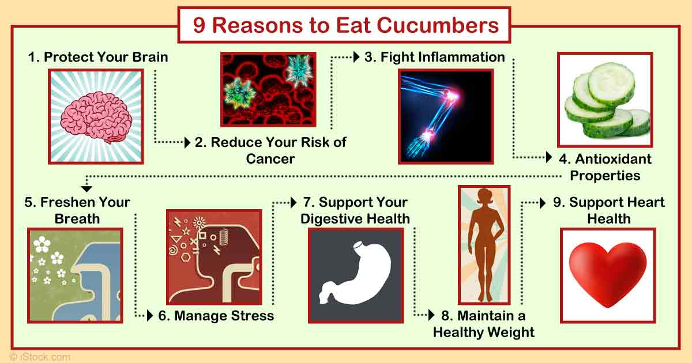

Slide 48
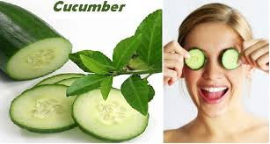
THANKS TO ALL

